Slide 1
Analysis on Multi-Modal Machine Translation and Image Captioning Models
Yvette Espinoza
Notes:
Similar to how deep learning revolutionized computer vision, it also revolutionized Natural Language Processing
In the past few years more focus has been on further combining the domains for increased task performance. One such example is in machine translation models

Slide 2
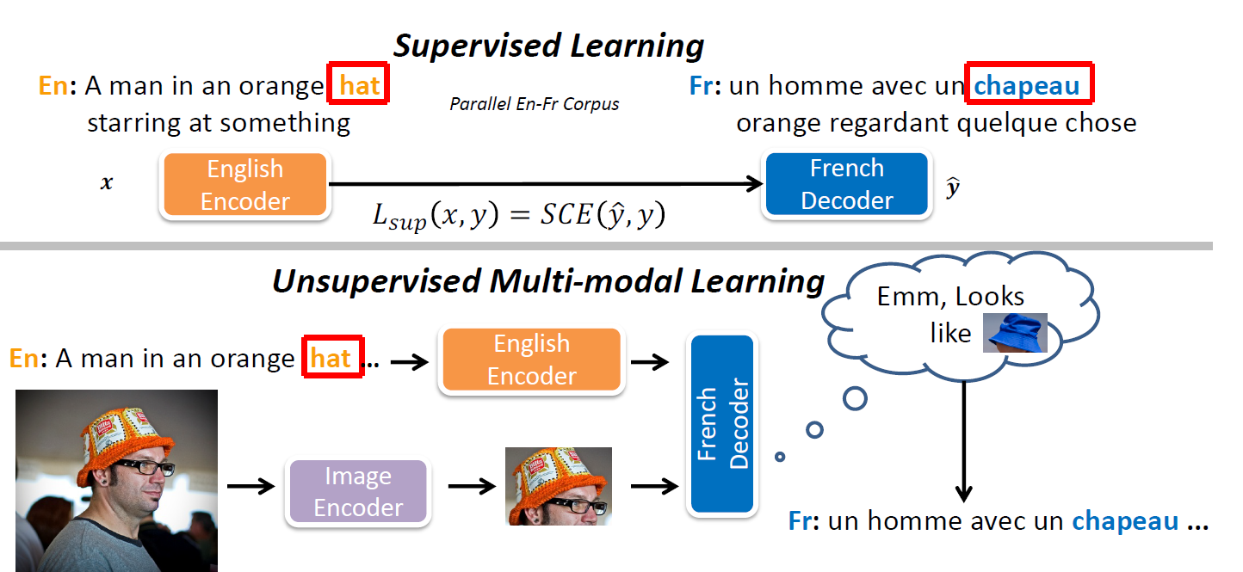
Multi-Modal Machine Translation Models
Yuanhang Su, Kai Fan, Nguyen Bach, C-C Jay Kuo, and Fei Huang. Unsupervised multi-modal neural machine translation. In CVPR, 2019.
Notes:
One such combination of CV and NLP include Multi-modal machine translation models

Slide 3
Transform and Tell: Entity-Aware News Image Captioning
Alasdair Tran, Alexander Mathews, Lexing Xie
CVPR 2020

Slide 4
Motivation
Previous captioning models have two limitations:
Models fail to apply real world knowledge (e.g. names and entities)
Inability to generate linguistically diverse captions due to model’s fixed size vocabulary
Proposal
Multi-modal, multi-head attention mechanism to associate faces and objects in images with names and descriptions from the article
Byte-pair encoding to generate unseen words
Notes:
Problem with fixed size vocabulary as defined in the paper → old training data can cause inconsistencies with current speech
Walk-man in the 1990’s equivalent to mp3 player in 2000’s

Slide 5
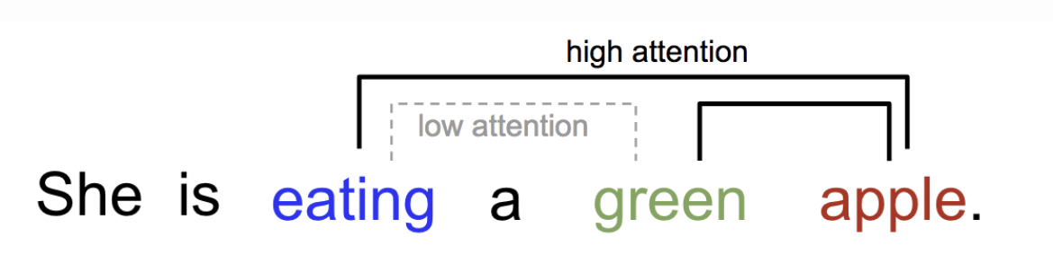
Transformers
First introduced in [3]
Model relying on attention mechanism to obtain dependencies between input and outputs
Benefits
Ability to represent word dependencies regardless of input text size
[3] Ashish Vaswani, Noam Shazeer, Niki Parmar, Jakob Uszkoreit, Llion Jones, Aidan N Gomez, Ł ukasz Kaiser, and Illia Polosukhin. Attention is all you need. In Advances in Neural Information Processing Systems 30, pages 5998–6008. Curran Associates, Inc., 2017.
[4] https://lilianweng.github.io/lil-log/2018/06/24/attention-attention.html
Notes:
Transformers were originally only in NLP, but have been adjusted for images in the last few years
Attention is used to get an understanding of relevant words/components in the sequence being processed. It gives weights to the relationship between words in a sentence and their context.

Slide 6
Byte Pair Encoding (BPE)
Data compression technique where the most common pairs of consecutive bytes are replaced with a byte not in the data
Modified by [1] to perform subword tokenization
Benefits of BPE, provided by [2]
Learning “old”, “older”, “oldest”
Provides information for “smart”, “smarter”, “smartest”
[1] Rico Sennrich, Barry Haddow, and Alexandra Birch. Neural machine translation of rare words with subword units. In Proceedings of the 54th Annual Meeting of the Association for Computational Linguistics (Volume 1: Long Papers), pages 1715–1725, Berlin, Germany, Aug. 2016. Association for Computational Linguistics.
[2] https://leimao.github.io/blog/Byte-Pair-Encoding/
Notes:
Subwords in example “er”, “est”

Slide 7
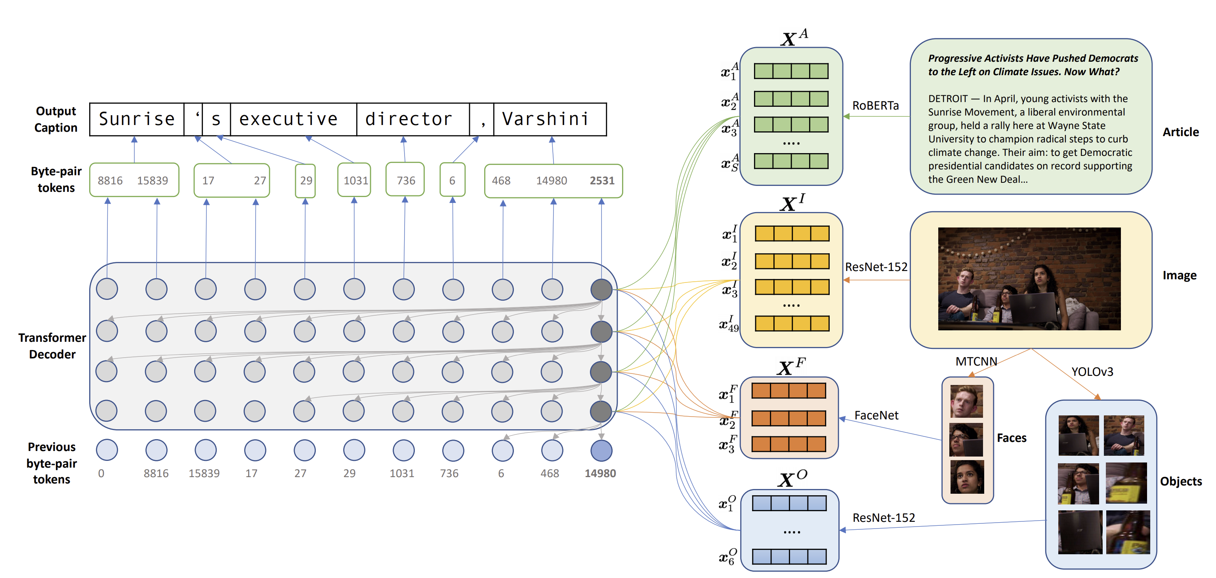
The model
Alasdair Tran, Alexander Mathews, and Lexing Xie. Transform and Tell: Entity-Aware News Image Captioning. In CVPR 2020.
Notes:
Model consists of:
4 transformer encoders (article, image, faces, objects)
produces attention over the 4 domains
1 transformer decoder

Slide 8
The model – Article Encoder
Alasdair Tran, Alexander Mathews, and Lexing Xie. Transform and Tell: Entity-Aware News Image Captioning. In CVPR 2020.
Notes:
RoBERTa Model → pretrained model with 24 layer of bidirectional transformer blocks
One goal was rare word generations, so RoBERTa was chosen
Design decision on text encoder type: GloVe vs RoBERTa vs weighted RoBERTa
RoBERTa uses Byte Pair Encoding (combined with attention, one word many different vectors depending on context) → unbounded vocabulary
GloVE embeddings (1 word one representation) has fixed vocabulary

Slide 9
The model – Image Encoders
Alasdair Tran, Alexander Mathews, and Lexing Xie. Transform and Tell: Entity-Aware News Image Captioning. In CVPR 2020.
Notes:
Model needs to detect faces and objects to provide the proper names
Using image itself as an input (instead of just the faces and objects) to attend to different regions in an image which is known to improve performance
Treating Faces and objects by themselves (even though they can be obtained from the actual image) also helps since the face encoder is specialized to identify people which will help the decoder generate more accurate named entities

Slide 10
The model – Caption Decoder
Alasdair Tran, Alexander Mathews, and Lexing Xie. Transform and Tell: Entity-Aware News Image Captioning. In CVPR 2020.
Notes:
Generates caption tokens sequentially, attention occurs over 4 domains (text, image, faces, objects)
Decoder type: LSTM vs Transformer
LSTM (Long Short Term Memory) Models use templates for captions: “PERSON speaks at BUILDING in DATE”
Transformer outperforms RNN, suitable for transfer learning, don’t require use of a template

Slide 11
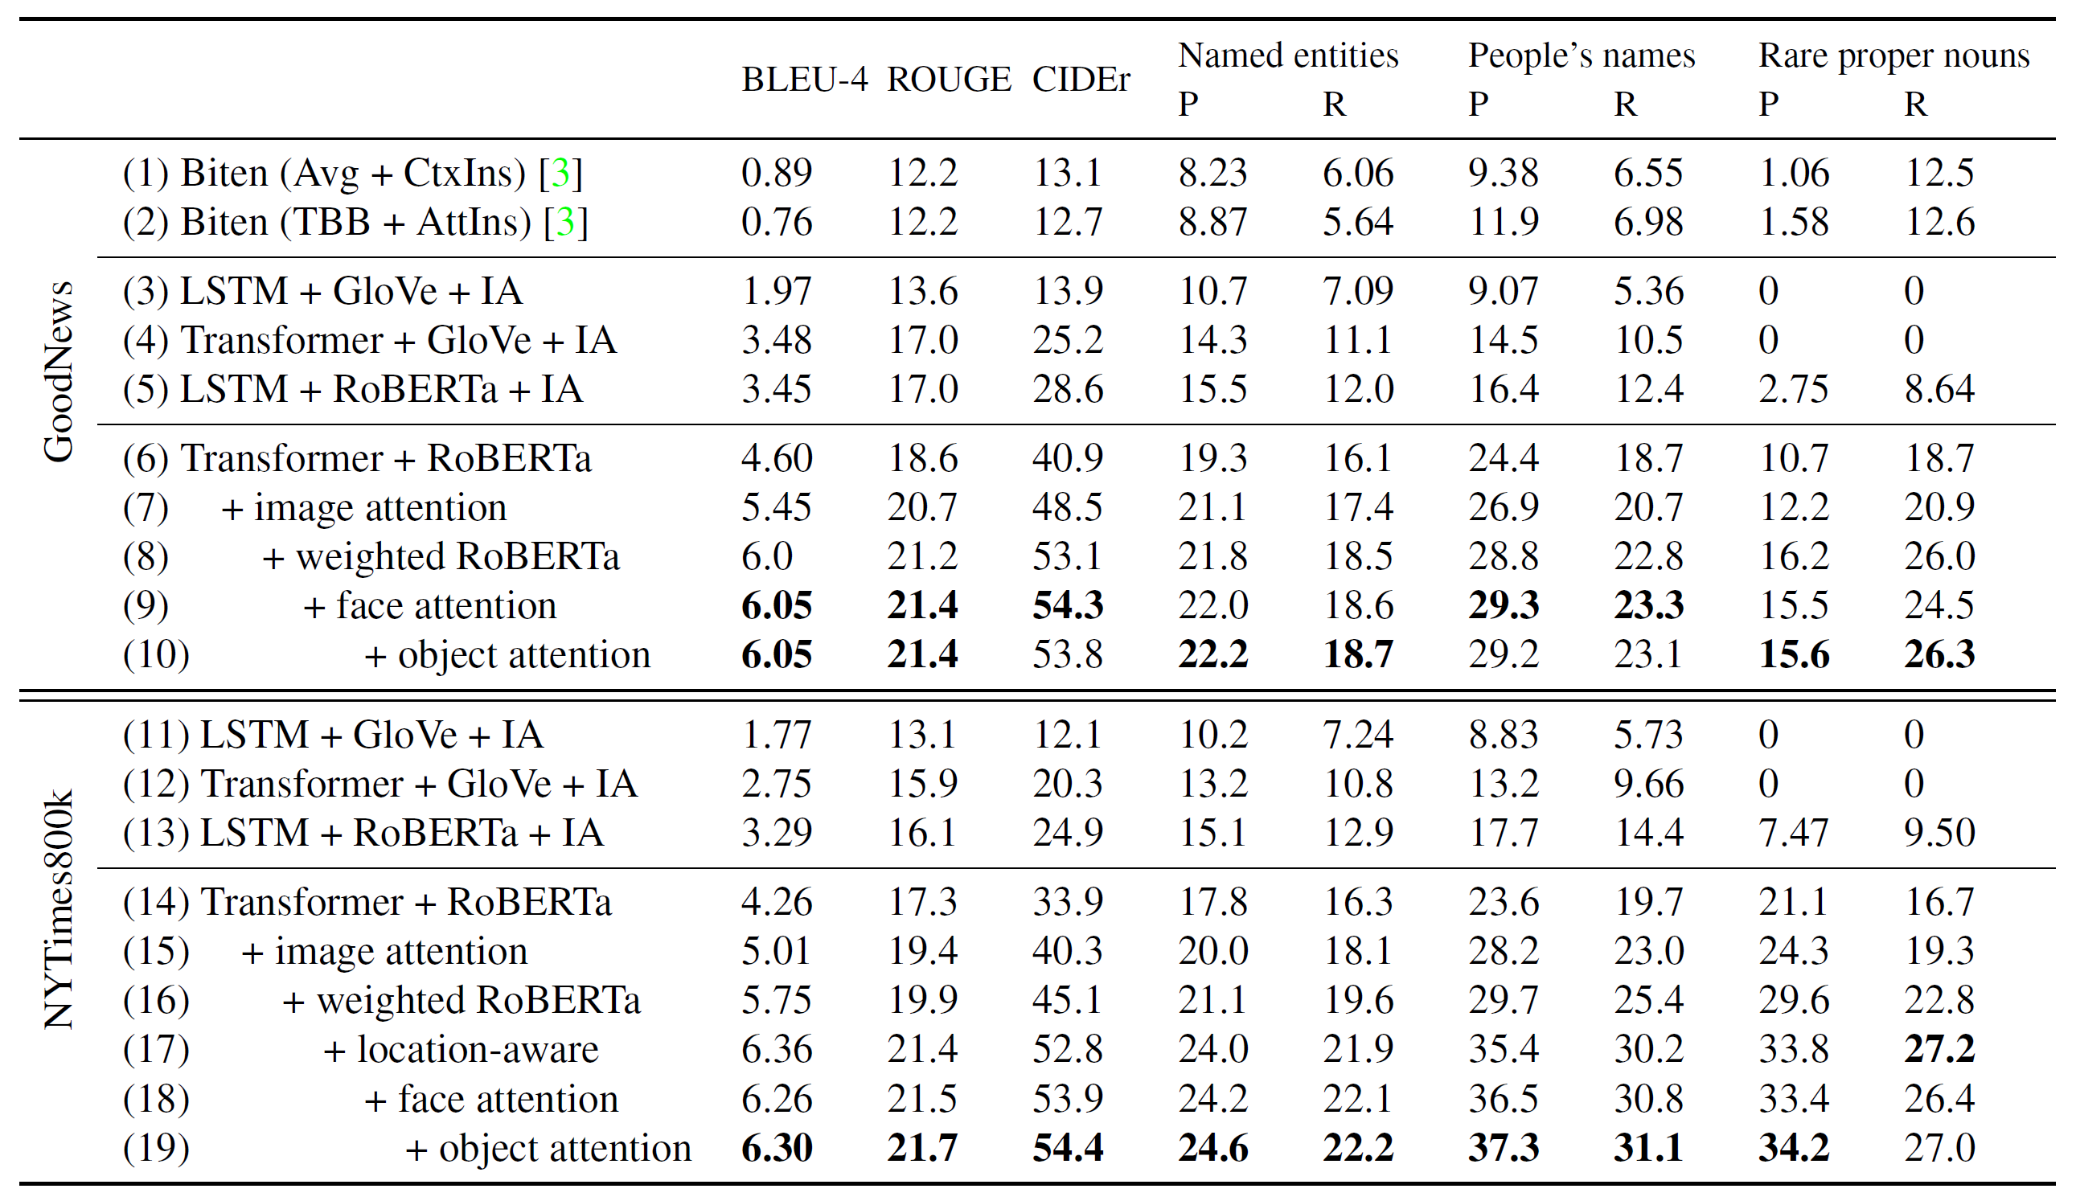
Results
Alasdair Tran, Alexander Mathews, and Lexing Xie. Transform and Tell: Entity-Aware News Image Captioning. In CVPR 2020.
Notes:
Part of their experiment included compiling a new dataset (NYTimes800K) since GoodNews had issues with missing article text, non-English articles, and captioned images that had nothing to do with the main article.
The more attention domains were added the better the model performed.

Slide 12
Visual Grounding in Video for Unsupervised Word Translation
Gunnar A. Sigurdsson, Jean-Baptiste Alayrac, Aida Nematzadeh, Lucas Smaira, Mateusz Malinowski, João Carreira, Phil Blunsom, Andrew Zisserman
CVPR 2020

Slide 13
Motivation
Current text-based word mapping models rely on:
Similarity between two languages
Similarity of the two languages’ training corpora
Amount of training data
Problems
Such models not scalable
Limits on availability of paired training corpora
Performance relies on similarity of languages and training corpora
Proposal
Unsupervised word translation model using only unpaired instructional videos
Notes:
Current models are difficult to scale for low-resource languages
Similarity between languages → English sentence structure more similar to French than Korean
English-French mapping is therefore almost a word-to-word mapping
Models performance measured by accuracy of word translation so similarity of the training corpora important for successful models

Slide 14
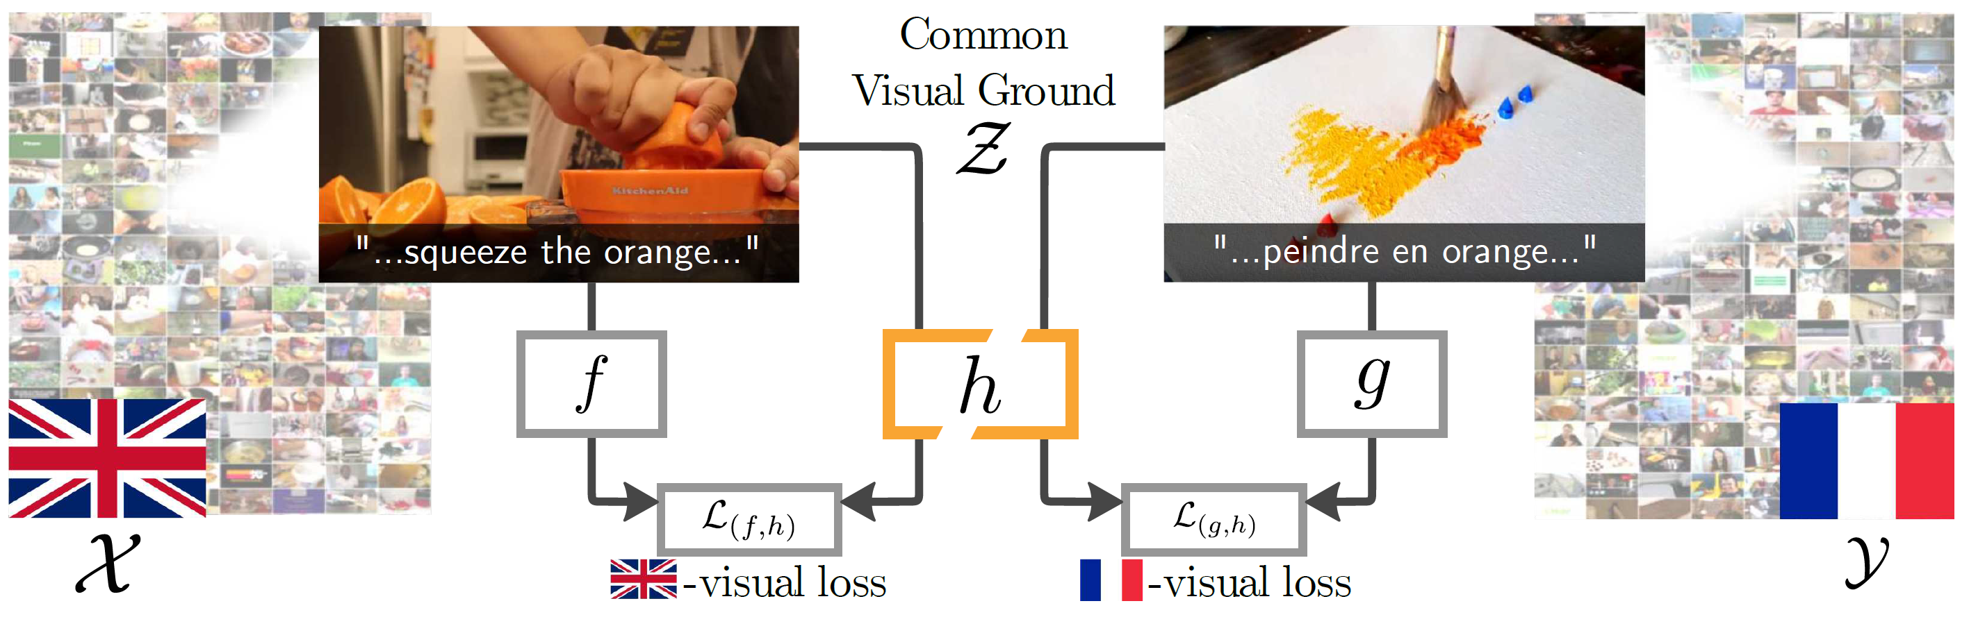
How it works
Gunnar A. Sigurdsson, Jean-Baptiste Alayrac, Aida Nematzadeh, Lucas Smaira, Mateusz Malinowski, Joao Carreira, Phil Blunsom, and Andrew Zisserman. Visual Grounding in Video for Unsupervised Word Translation. In CVPR 2020.
Notes:
Example of their proposal:
Video of squeezing an orange in English, video of painting with color orange in French
Model uses both videos (with subtitles) to create a mapping of orange in English to orange in French

Slide 15
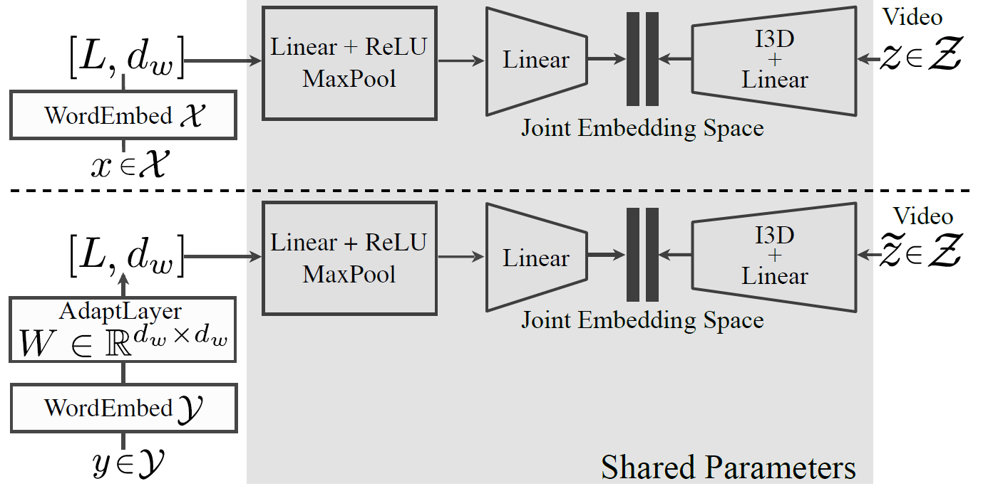
The Model
Inputs:
X language subtitles from video z
Y language subtitles from video z’
Sharing of model allows for word alignment
Gunnar A. Sigurdsson, Jean-Baptiste Alayrac, Aida Nematzadeh, Lucas Smaira, Mateusz Malinowski, Joao Carreira, Phil Blunsom, and Andrew Zisserman. Visual Grounding in Video for Unsupervised Word Translation. In CVPR 2020.
Notes:
WordEmbed layer → takes input of tokens and outputs L vectors of dimension
wordEmbed layer sends text into the encoder that goes into the joint embedding space along with the video encoder output
This component is shared between the two languages
The only difference between the processing of the two languages is that in the second language has an adapt layer (just a linear layer)
Note on Adapt Layer (just a linear layer)
used to transform word embedding space of y to be similar to embedding space of x
allows the rest of the embedding to be shared
Sharing model → part of problem they are solving is that models rely on languages being similar structured to get good results. Using the adapt layer and sharing parameters addresses this problem.

Slide 16
Implementation
Datasets
HowTo100M
Word2vec embeddings
Training
First language video extracts features,
Find closest videos in second language
Created paired data from the subtitles
Align words to create a word mapping
Notes:
HowTo100M is a YouTube dataset → used existing automatic speech recognition programs to obtain subtitles in French, Japanese, and Korean
Word2vec was a consideration in the Transform and Tell model, but since word2vec produces exactly one representation for each word it does a better job in the word translation model

Slide 17
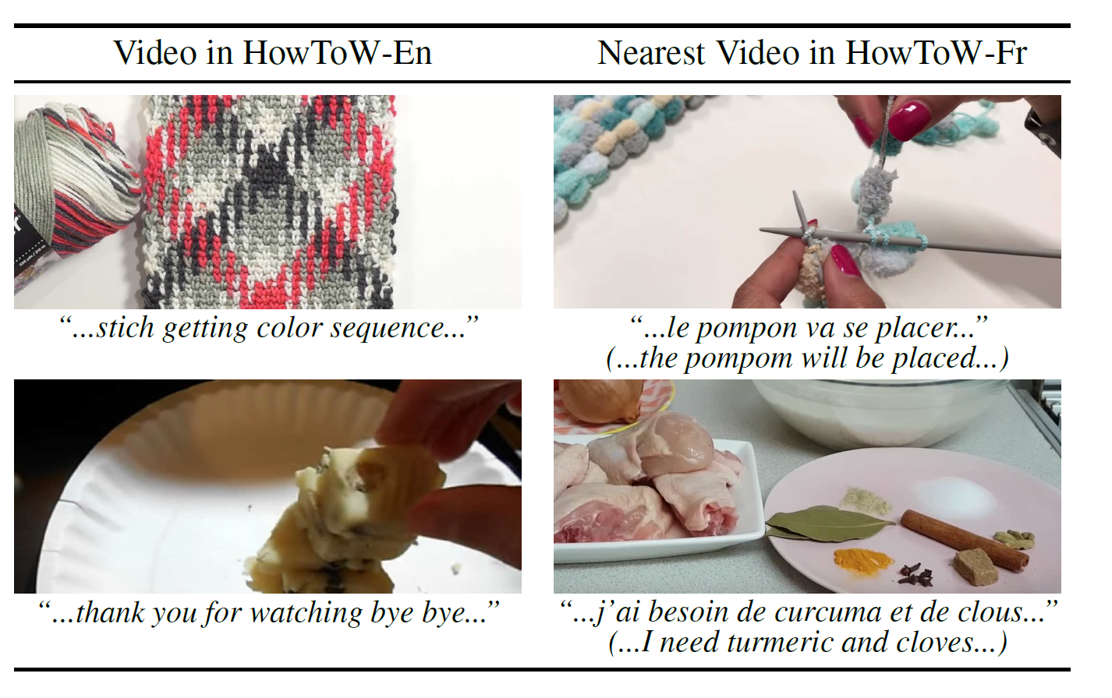
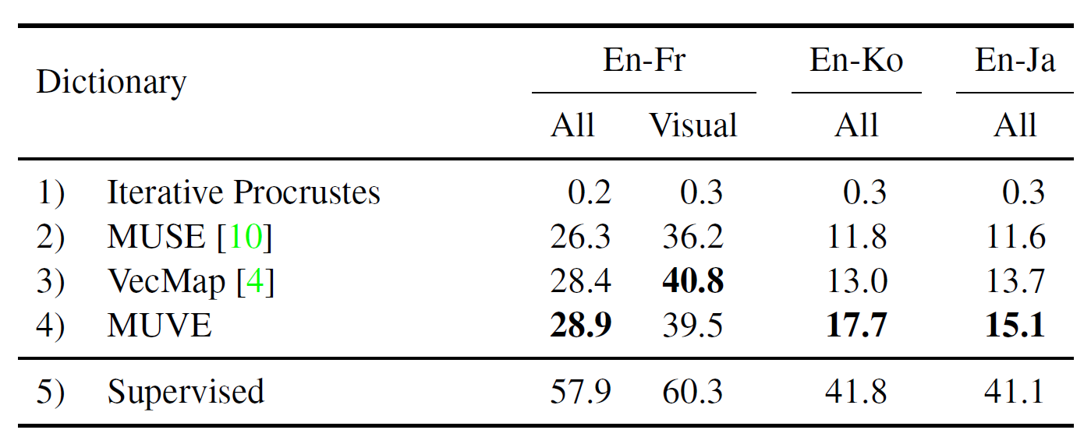
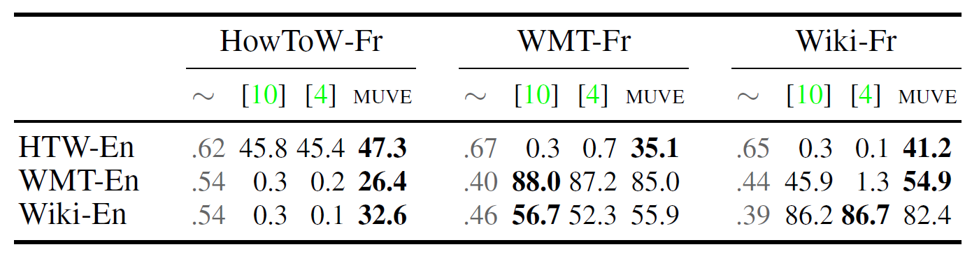
Results
Gunnar A. Sigurdsson, Jean-Baptiste Alayrac, Aida Nematzadeh, Lucas Smaira, Mateusz Malinowski, Joao Carreira, Phil Blunsom, and Andrew Zisserman. Visual Grounding in Video for Unsupervised Word Translation. In CVPR 2020.
Notes:
Left→ example of a failure (since some videos talk about random stuff while performing their task) top videos are visually related, but words don’t match.
Top Right → MUVE is the model created, shows that model performed better than text-only models for non similar languages
Bottom Right → dissimilarity between training sets and effectiveness of model compared to text based models
ex: Wiki-En and Wiki-Fr similar (dissimilarity of 0.39) so VecMap performs best (text only)
HowToEn and WMT-Fr highest dissimilarity (0.67), MUVE produced the best results

Slide 18
Unsupervised Multi-modal Neural Machine Translation
Yuanhang Su, Kai Fan, Nguyen Bach , C. -C. Jay Kuo, Fei Huang
CVPR 2019

Slide 19
Motivation
Improve performance of Universal Neural Machine Translation (UNMT) models
Proposal
Unsupervised multi-modal machine translation framework
Notes:
Uses multi-head self-attention transformer (to mimic convolution operation)

Slide 20
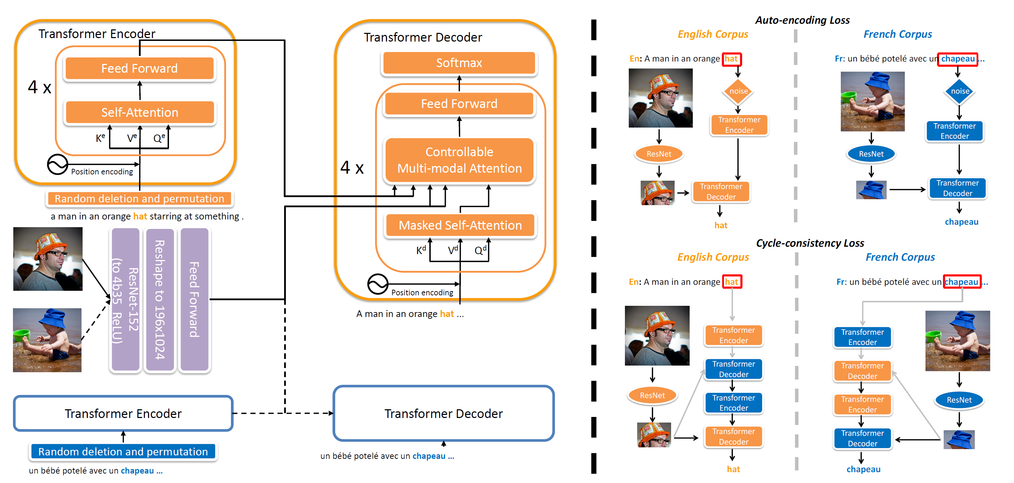
The Model
Yuanhang Su, Kai Fan, Nguyen Bach, C-C Jay Kuo, and Fei Huang. Unsupervised multi-modal neural machine translation. In CVPR, 2019.
Notes:
5 components:
2 encoders for source and target languages
2 decoders for source and target languages
1 image encoder

Slide 21
The Model – Text Encoders
Yuanhang Su, Kai Fan, Nguyen Bach, C-C Jay Kuo, and Fei Huang. Unsupervised multi-modal neural machine translation. In CVPR, 2019.
Notes:
2 encoders, one for language 1 (English) and language 2 (French in this case)
4-layer transformers, dimensionality 512 → typical transformer/attention architecture

Slide 22
The Model – Image Encoders
Yuanhang Su, Kai Fan, Nguyen Bach, C-C Jay Kuo, and Fei Huang. Unsupervised multi-modal neural machine translation. In CVPR, 2019.
Notes:
Pretrained Resnet-152 used

Slide 23
The Model – Decoders
Yuanhang Su, Kai Fan, Nguyen Bach, C-C Jay Kuo, and Fei Huang. Unsupervised multi-modal neural machine translation. In CVPR, 2019.
Notes:
Typical transformer decoder too, but a modification is that sometimes an image will not be present
→ Controllable attention module that accounts for the presence of an image

Slide 24
The Model – Training Paths
Yuanhang Su, Kai Fan, Nguyen Bach, C-C Jay Kuo, and Fei Huang. Unsupervised multi-modal neural machine translation. In CVPR, 2019.
Notes:
4 training paths (2 for each language)
Auto-encoding loss path: text goes through its encoder, image goes through image encoder and decoder output gives output
Cycle-consistency loss path: text goes through its encoder, then the other language decoer-encoder before coming back to its decoder to get the word
based on CycleGan and DualLearning for Machine translation paper (2016)

Slide 25
Implementation
Dataset
WMT News Crawl datasets, 2017-2017
Multi30K dataset
BPE embeddings
Training
Text only model (pretraining)
Text and image model with pretraining
Text and image model without pretraining
Notes:
News Crawl datasets (text only)
used for pretraining the embeddings that will be used to initialize the model
Multi30K dataset (text + image)
2016 files used to evaluate English-French and English-German language pairs
BPE chosen → though no explanation on why it had to be BPE
Training in 3 ways:
Text only, text+image+pretrained, text+image

Slide 26
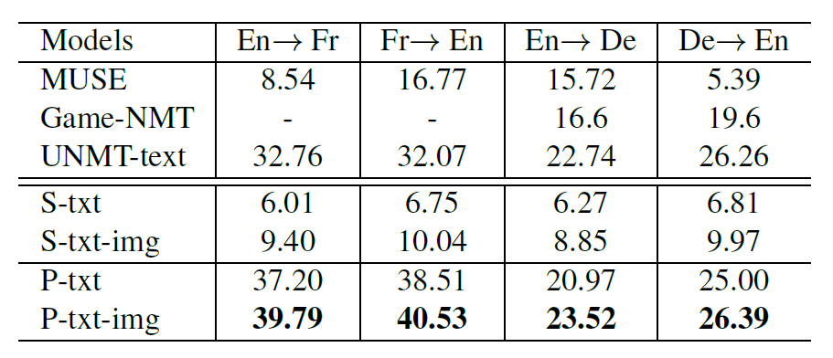
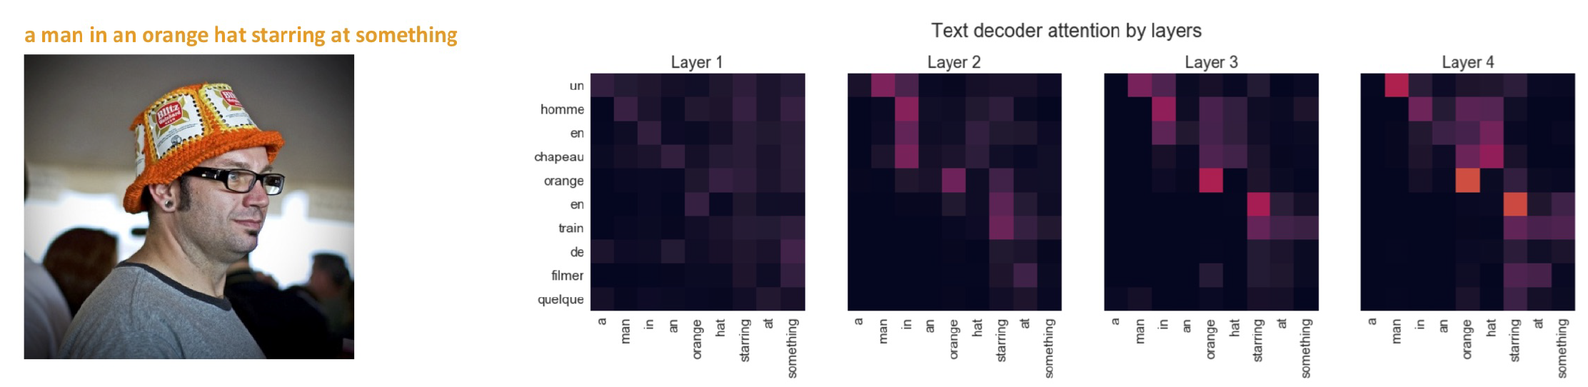
Results
Yuanhang Su, Kai Fan, Nguyen Bach, C-C Jay Kuo, and Fei Huang. Unsupervised multi-modal neural machine translation. In CVPR, 2019.
Notes:
BLEU scoring of the model compared with the others. The S indicate models without pretraining, and the p contain pretraining
This paper was mentioned in Visual Grounding as an example of translation that is good only when the languages are similar
the paper even mentioned text attention good (diagonal) since the languages were similar in grammatical structures

Slide 27
Implementation
Attempt to reproduce the Unsupervised Multi-Modal Neural Machine Translation Model

Slide 28
Word Processing
Pretraining text model
Followed what was done in [4]
News Crawl Datasets: 2019 English, 2018 German
BPE embeddings using Fasttext
Training
Multi30K Datasets: reduced version of the 2007 datasets for English and German
[4] Guillaume Lample, Myle Ott, Alexis Conneau, Ludovic Denoyer, and Marc’Aurelio Ranzato. Phrase-based & neural unsupervised machine translation. In Proceedings of the 2018 Conference on Empirical Methods in Natural Language Processing (EMNLP), 2018.
Notes:
News Crawl Dataset
http://data.statmt.org/news-crawl/de/
http://data.statmt.org/news-crawl/en/
Reduced Multi30K had the first 100 images with sentences

Slide 29
Design choices
Used Tensorflow
Pytorch would have been better option though
Generated embeddings used to initialize the encoders and decoders
Pre-trained ResNet-152 used
Problems encountered
Problem implementing controllable attention
Notes:
Tensorflow used since had lots of help docs
Pytorch better though → torch.nn.Transformer is a package that has transformer and attention modules already implemented
Controllable attention → getting the correct dimensions for passing in image to a text based transformer

Slide 30
Thank you!

Slide 31
Useful links / references
Models with Attention
https://jalammar.github.io/visualizing-neural-machine-translation-mechanics-of-seq2seq-models-with-attention/
Recurrent Neural Network Overview
https://www.youtube.com/watch?v=UNmqTiOnRfg&ab_channel=LuisSerrano
Example of Neural Machine Translation
https://github.com/tensorflow/nmt
Multi-head self-attention transformer
http://jalammar.github.io/illustrated-transformer/
Overview of Cycle GAN
https://towardsdatascience.com/overview-of-cyclegan-architecture-and-training-afee31612a2f
Byte Pair Encoding
https://medium.com/@makcedward/how-subword-helps-on-your-nlp-model-83dd1b836f46

Slide 32
Other Resources
https://www.tensorflow.org/tutorials/keras/text_classification
https://www.tensorflow.org/tutorials/text/nmt_with_attention
https://www.tensorflow.org/api_docs/python/tf/keras/layers/Conv2D
https://www.tensorflow.org/api_docs/python/tf/keras/datasets
https://jalammar.github.io/
https://jalammar.github.io/a-visual-guide-to-using-bert-for-the-first-time/
https://medium.com/@adityathiruvengadam/transformer-architecture-attention-is-all-you-need-aeccd9f50d09
https://github.com/facebookresearch/fastText/blob/master/docs/python-module.md
https://github.com/facebookresearch/fastText/blob/master/docs/unsupervised-tutorials.md
https://github.com/facebookresearch/fastText/blob/a20c0d27cd0ee88a25ea0433b7f03038cd728459/python/fasttext_module/fasttext/FastText.py#L80
https://github.com/facebookresearch/fastText
https://github.com/facebookresearch/fastText/tree/master/alignment
Notes:
Google searches:
tf.keras.layers

Slide 33
Other Resouces
https://www.youtube.com/c/LuisSerrano/videos
https://www.youtube.com/c/BrandonRohrer/playlists
https://colab.research.google.com/github/tensorflow/tensor2tensor/blob/master/tensor2tensor/notebooks/hello_t2t.ipynb
https://github.com/tensorflow/tensor2tensor
https://github.com/google/trax
https://trax-ml.readthedocs.io/en/latest/notebooks/trax_intro.html
https://github.com/tensorflow/nmt
https://www.tensorflow.org/tutorials/text/transformer
https://medium.com/inside-machine-learning/what-is-a-transformer-d07dd1fbec04
https://huggingface.co/blog/encoder-decoder
http://jalammar.github.io/illustrated-transformer/
https://towardsdatascience.com/transformers-141e32e69591
https://www.youtube.com/watch?v=D-ekE-Wlcds&ab_channel=XinRong
https://github.com/dipanjanS/practical-machine-learning-with-python/blob/master/bonus%20content/feature%20engineering%20text%20data/Feature%20Engineering%20Text%20Data%20-%20Advanced%20Deep%20Learning%20Strategies.ipynb
https://github.com/lilianweng/transformer-tensorflow/blob/master/transformer.py

Slide 34
Papers I can reference later
https://papers.nips.cc/paper/5346-sequence-to-sequence-learning-with-neural-networks.pdf
http://emnlp2014.org/papers/pdf/EMNLP2014179.pdf
https://arxiv.org/pdf/1706.03762.pdf
https://arxiv.org/abs/1703.10593

